Slide 1

AONE
Milestone 3
2023.07.13

Slide 2
Contents
Overview
ASR & Design decisions
Lesson learned

Slide 3
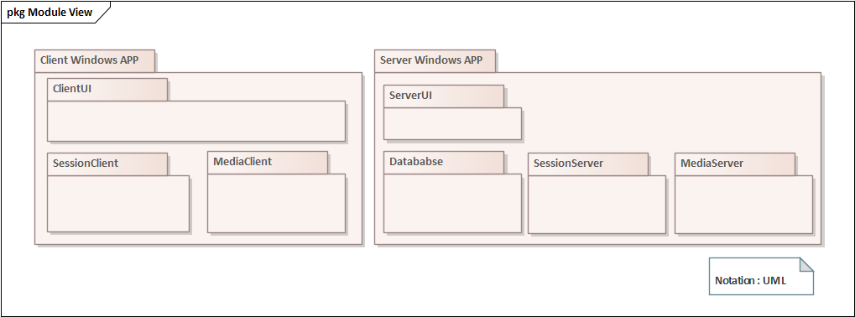
Overview
Three Major jobs & components (UI + Session + Media)
<First decomposition of overall architecture>
Notes:
First decomposition of overall architecture
Three Major jobs & components (UI + Session + Media)
UI
Session
Media

Slide 4
ASRs
Performance QA
Provides the best video quality suitable for the network situation.
Availability QA
Maintain stable video call under amount of network jitter
Availability QA
Maintain stable video call under amount of packet / data loss
Notes:
Let me explain the 3 most important Architectural Drivers among many QAs,

Slide 5
Key design decisions
ASR1: Use STAR (Client-server) media network w/ GStreamer library
ASR1: Dynamic video quality changes in network capacity changes
ASR2, 3: Detect & handle Jitter / Drop
Notes:
The key design decisions to achieve ASR are:
Use STAR (Client-server) media network w/ GStreamer library
Dynamic video quality changes in network capacity changes
Detect & handle Jitter / Drop

Slide 6
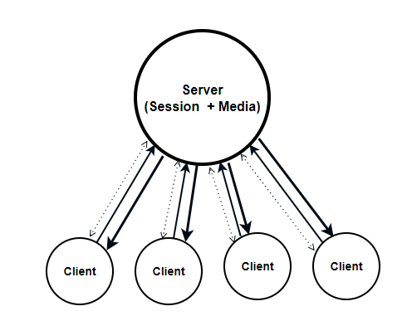
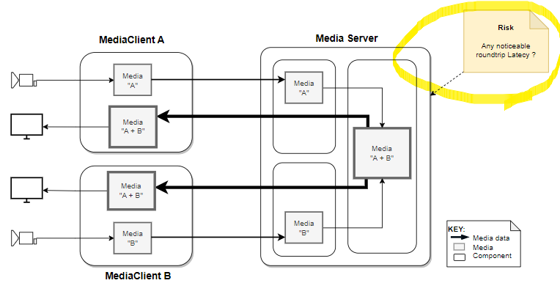
Key Design Decision #1 : Use STAR media network
Benefits
More available network capacity than MESH
Easy server management both session and media
Challenges
Server need composite video and mix audio
May cause more media latency
※ MESH : every device is directly connected to every other device in the network.

Slide 7
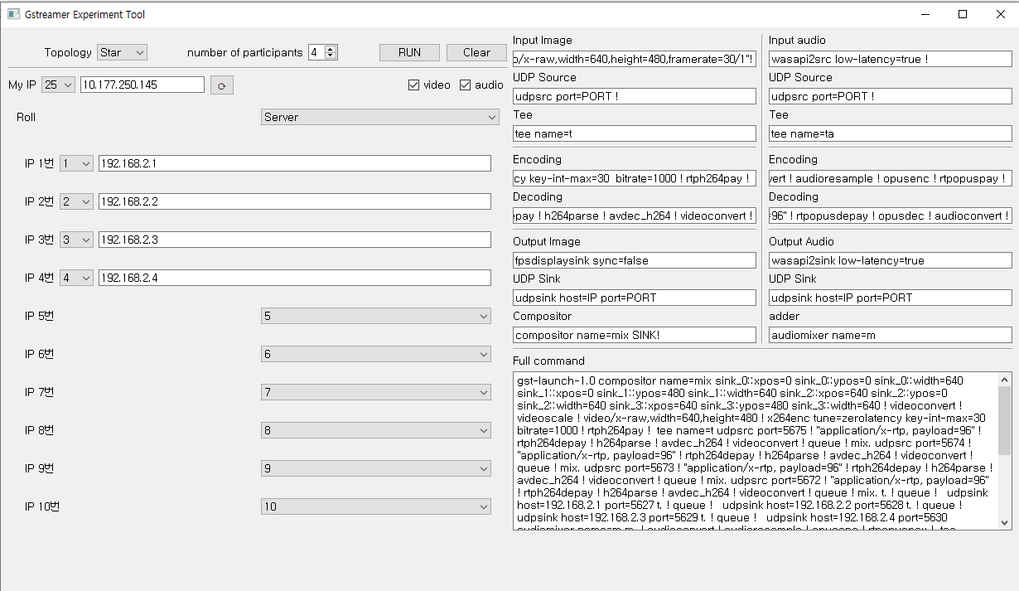
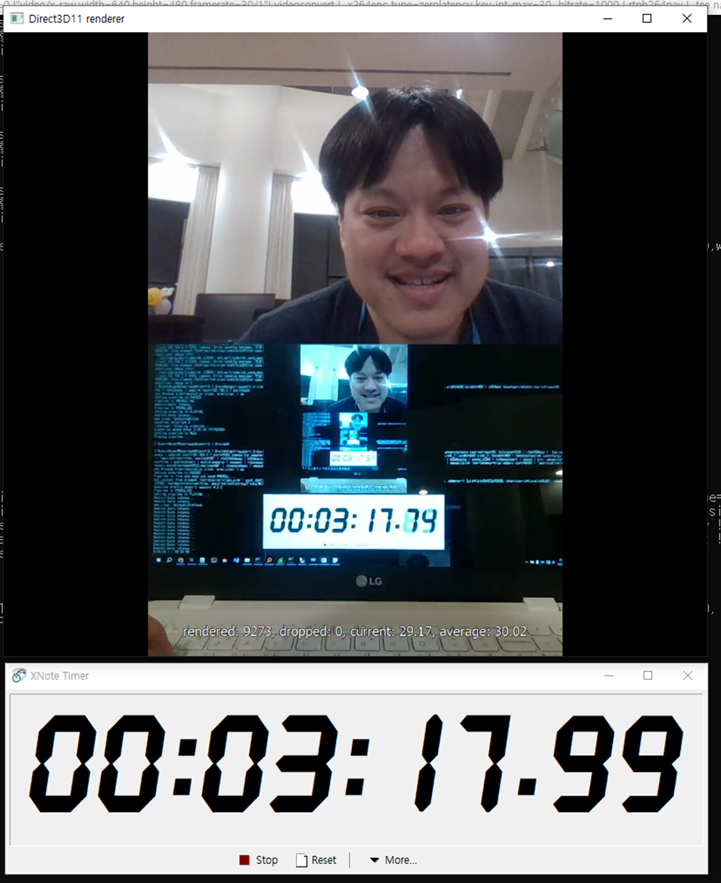
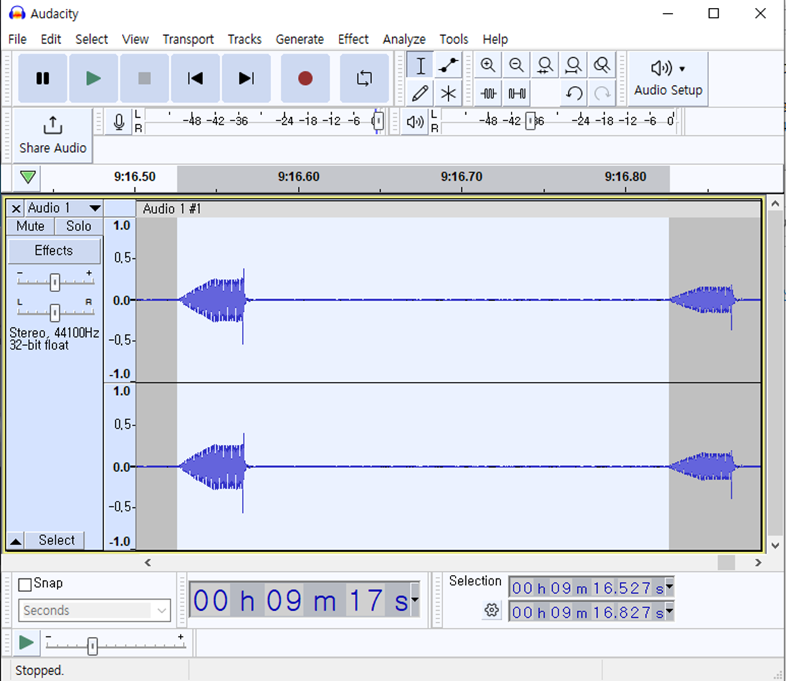
Key Design Decision #1 : Use STAR media network
Experiments results
STAR use less network capacity than MESH (eg. 10 persons for 90 Mbps vs 20 Mbps for same video)
GStreamer library integration for media composite is feasible
No noticeable media latency in the evaluation environment
We developed GStreamer CLI test tool using python
Video latency test using GStreamer CLI
Audio latency test using GStreamer CLI

Slide 8
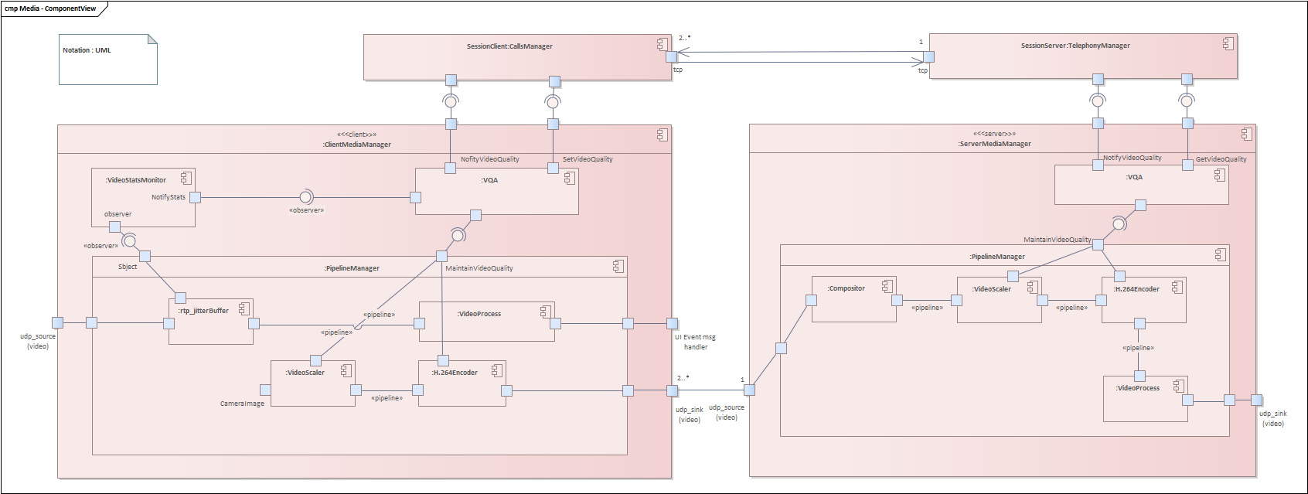
Key Design Decision #1 : Use STAR media network
Media composite / mix module
GStreamer Integration
GStreamer Integration
Media compositor
(Server)

Slide 9
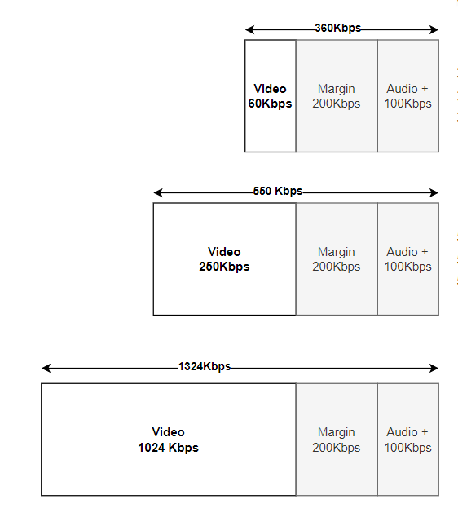
Key Design Decision #2 : Dynamic Video Quality Changes
Benefits
Maintains call under poor network capacity
Provides best quality video (bitrate)
Challenges
How to decide proper video quality
How to decide condition to change video quality

Slide 10
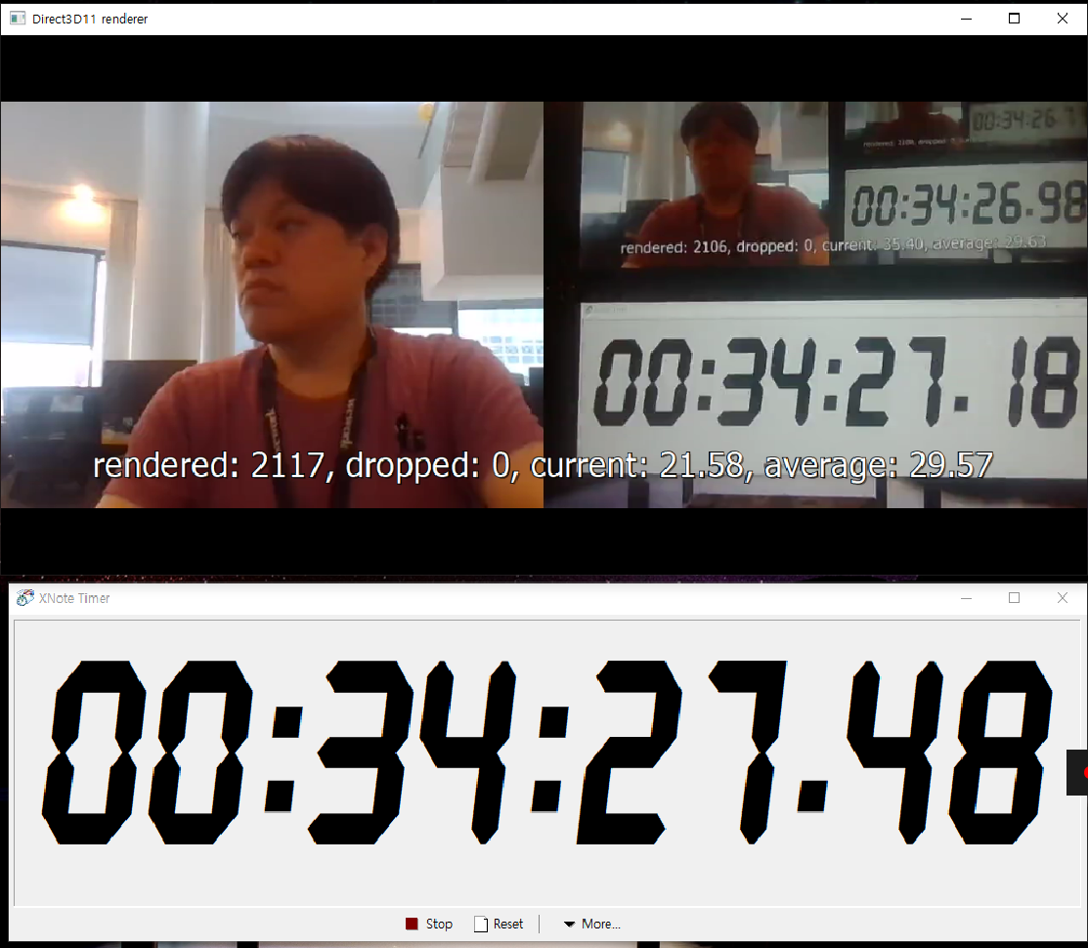
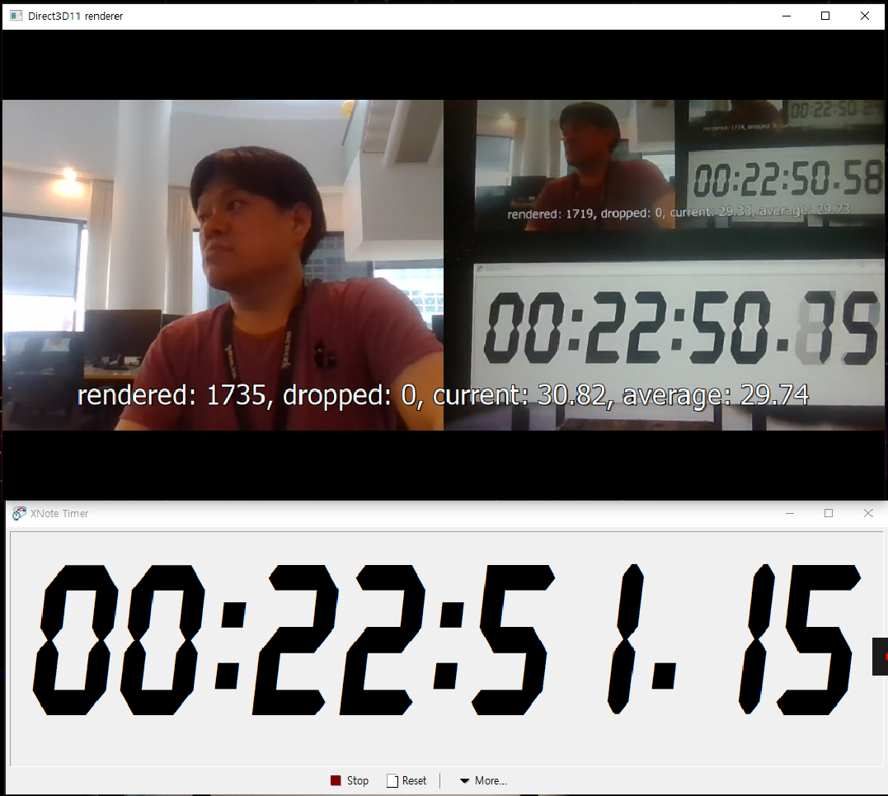
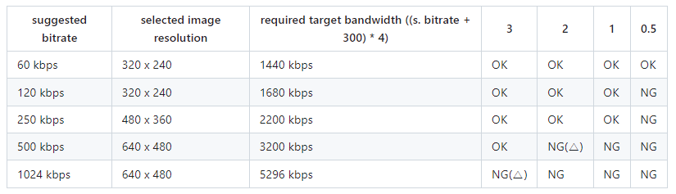
Key Design Decision #2 : Dynamic Video Quality Changes
Experiments results
Proper video quality presets from current network environment (High quality, less latency)
No noticeable media latency in the evaluation environment using presets
500kbps and bandwidth 2Mbps
100kbps and bandwidth 3Mbps
Define presets and validated them

Slide 11
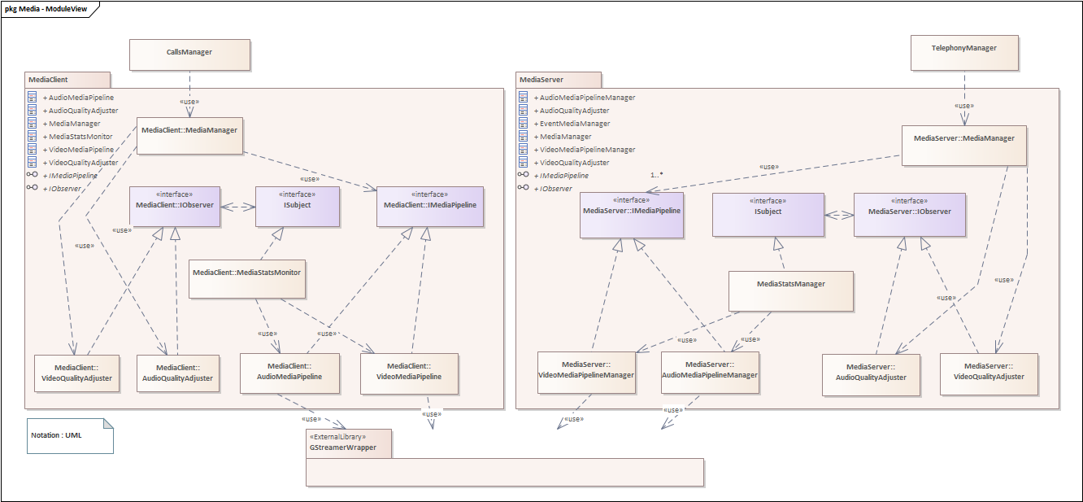
Key Design Decision #2 : Dynamic Video Quality Changes
Quality change modules
1. Get report (Jitter / Packet drop)from GStreamer
2. Report to Server
3. Request change video quality of every participants
GStreamer Integration

Slide 12
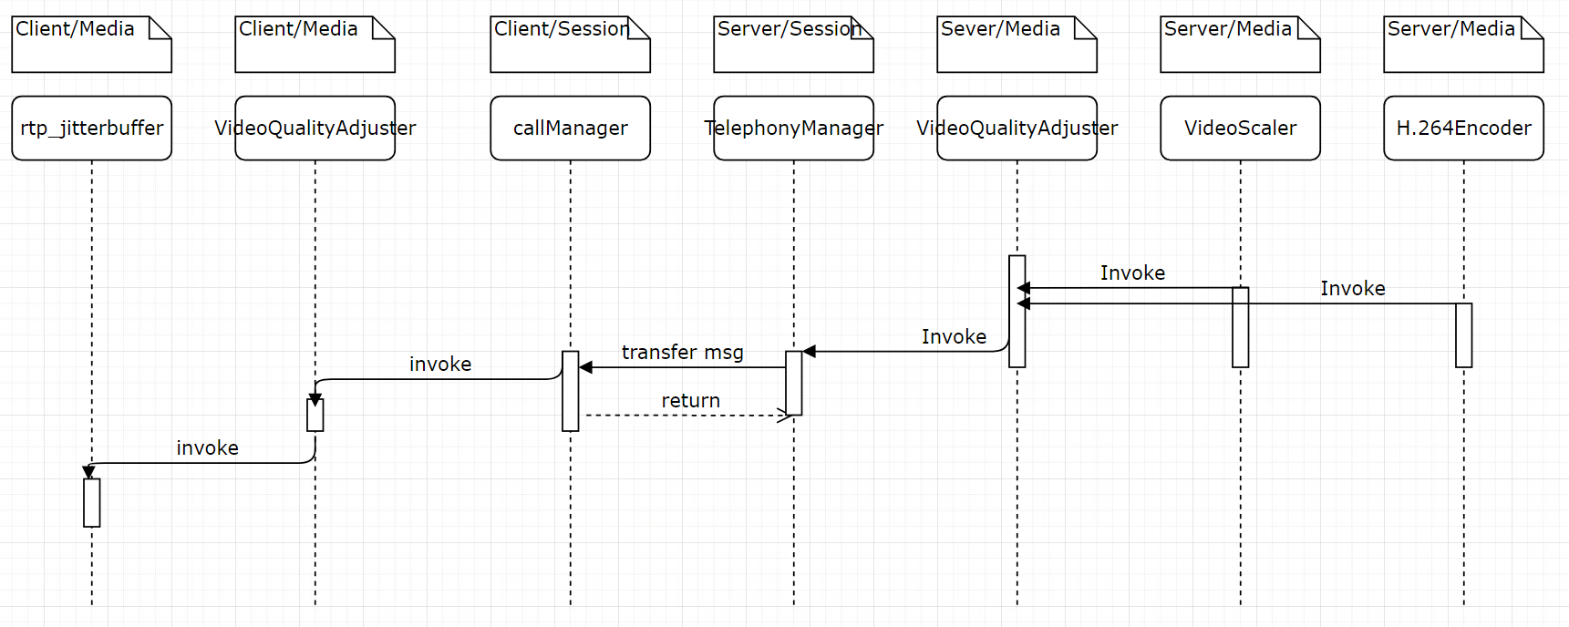
Key Design Decision #2 : Dynamic Video Quality Changes
Sequence Diagram for Media Video Quality Change
UML Notation

Slide 13
Key Design Decision #3 : Detect & handle Jitter / Drop
Benefits
Maintain stable video call under amount of network jitter
Maintain stable video call under amount of packet / data loss
Challenges
How to configure GStreamer jitter buffer and packet handling
How to find proper jitter buffer size

Slide 14
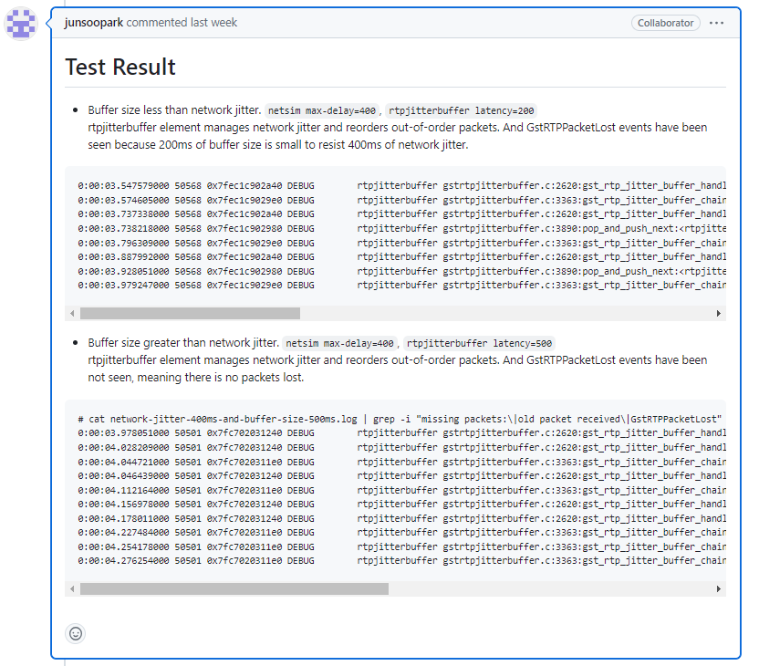
Key Design Decision #3 : Detect & handle Jitter / Drop
Experiments results
Found proper jitter buffer for proper latency
GStreamer Jitter buffer can be configured dynamically
GStreamer Decoder can be configured for packet drop management

Slide 15
Key Design Decision #3 : Detect & handle Jitter / Drop
Check network condition & handle
Jitter buffer
Decoder

Slide 16
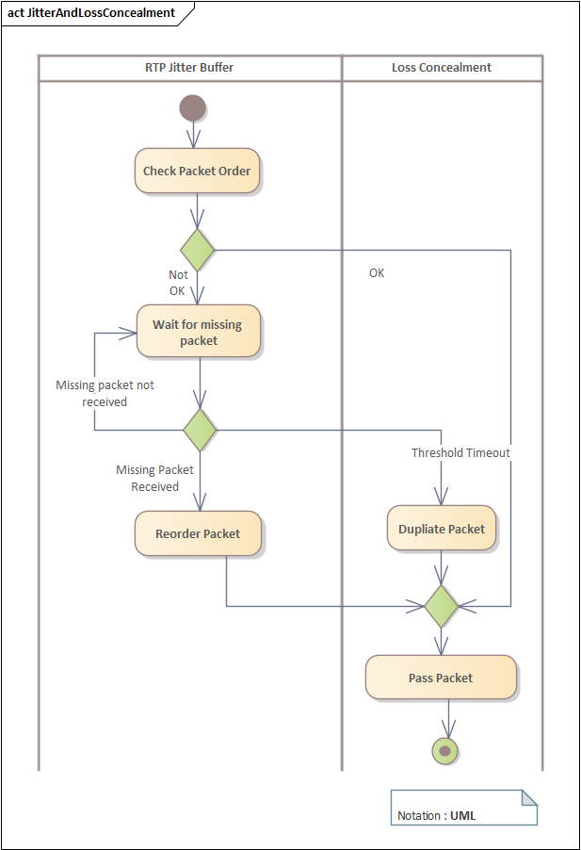
Key Design Decision #3 : Detect & handle Jitter / Drop
Network condition check & handle behavior
JitterBuffer
Decoder
JitterBuffer
Decoder

Slide 17
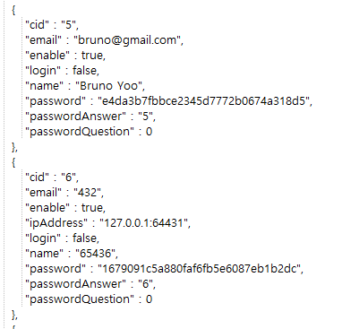
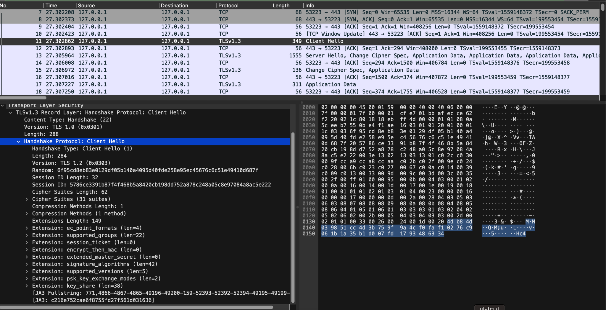
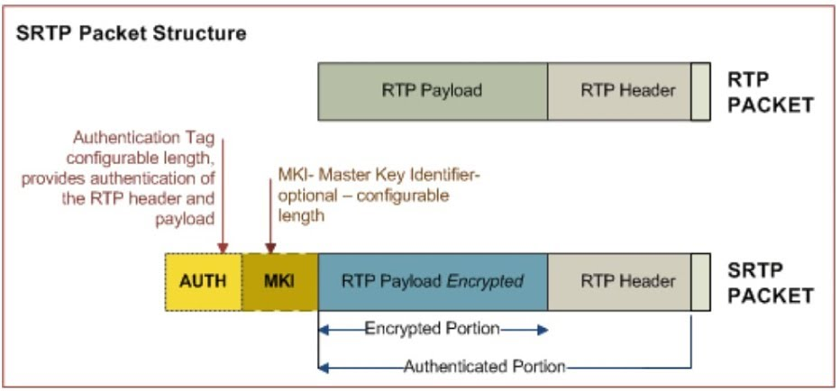
Other design decisions
Use JSON for session network and database
Use TLS(Transport Layer Security) / MD5 for session data security
Use SRTP(Secure Real-time Transport Protocol) for media data security
Ok for direct call, but Remove Conference call for some Issue – (freezing image while adding new user), need more time to optimizing
JSON Database (MD5 Password hashing)
TLS connection validation
How GStreamer SRTP works

Slide 18

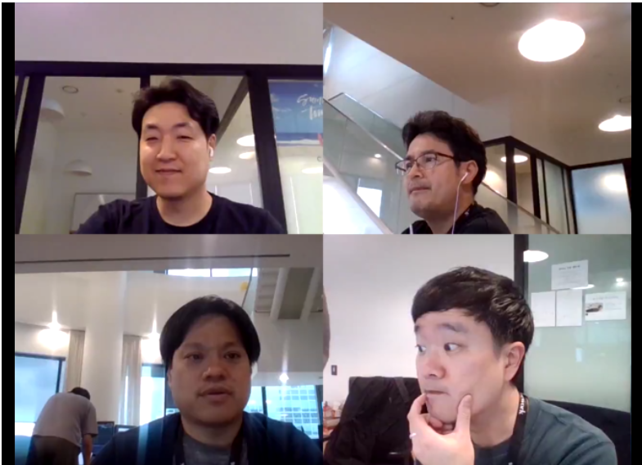
Lesson Learned
What didn’t go well?
Difficulties in applying GStreamer from CLI to actual code (eg. Media compositor, Quality change, Security integration)
Windows programming difficulties (eg. Thread, Maps…)
What worked well?
Database & account management w/ JSON
UI Controller / media module w/ Observer pattern
Right approach in real world.

Slide 19
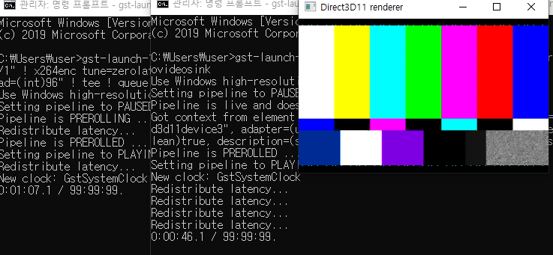
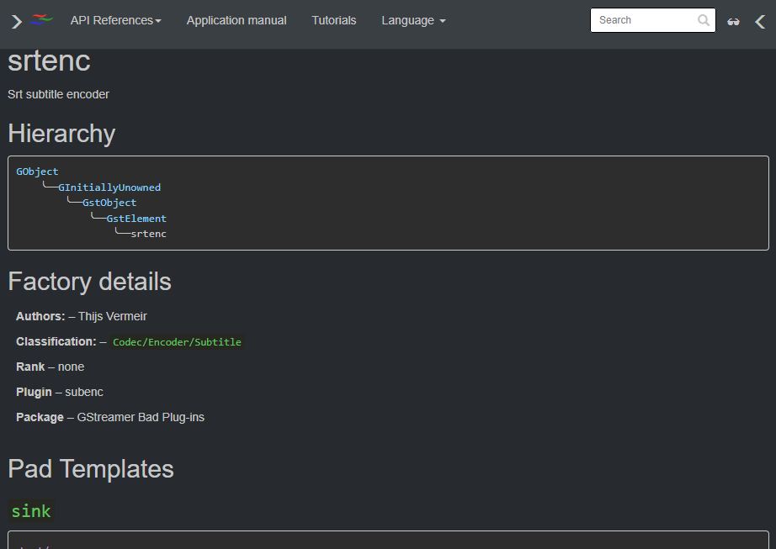
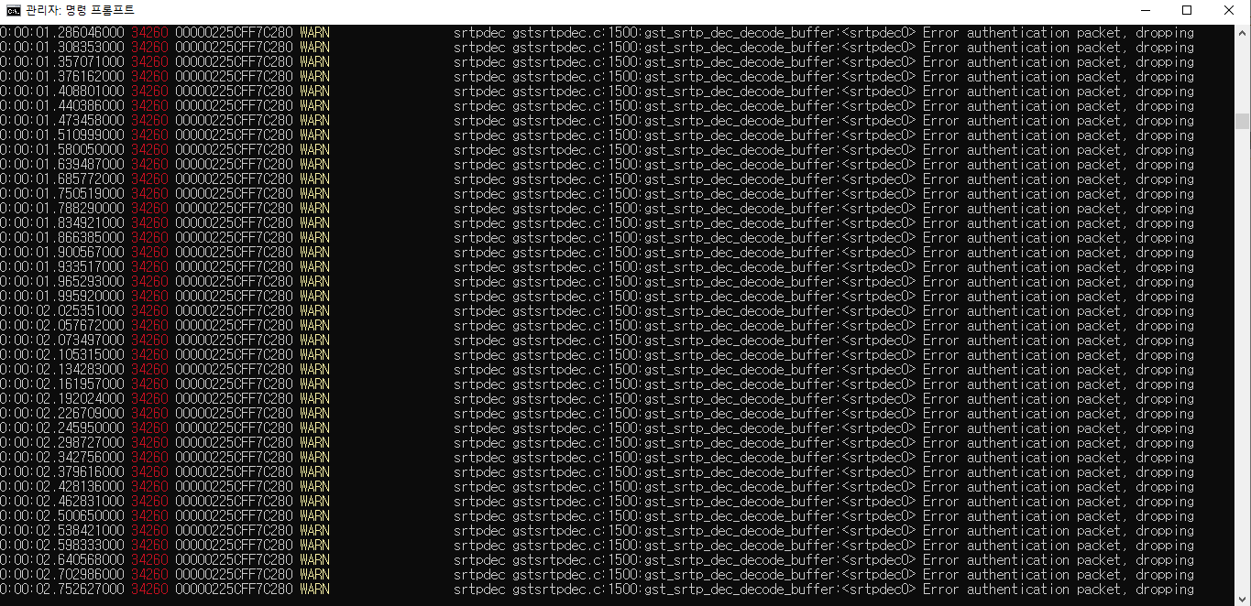
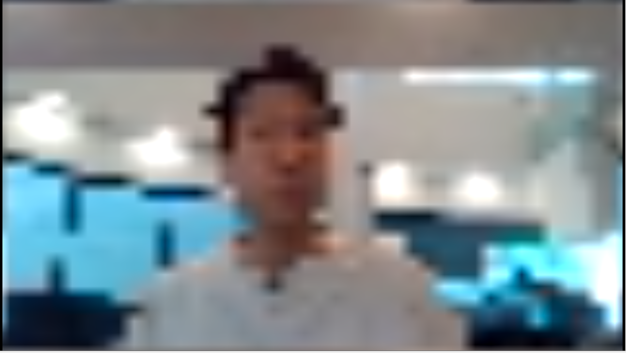
Lesson Learned : What didn’t go well
Difficulties in applying GStreamer from CLI to actual code
Simple and easy feasibility check via CLI
Actual SW implementation that was rough
Unfamiliar document
Many Issues
Unexpected result

Slide 20
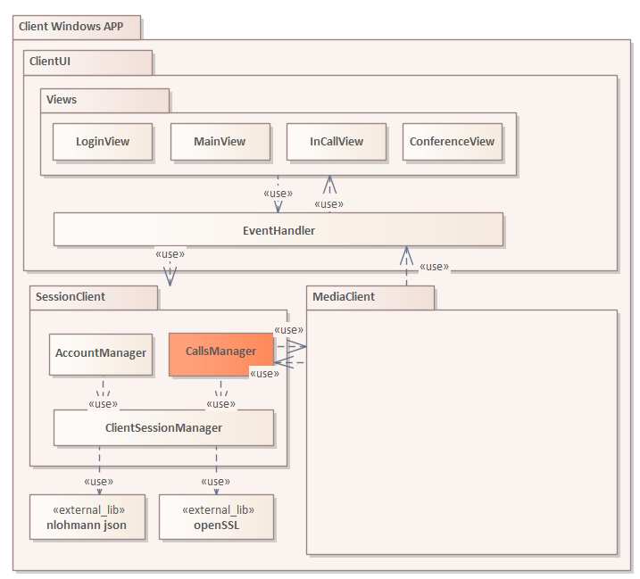
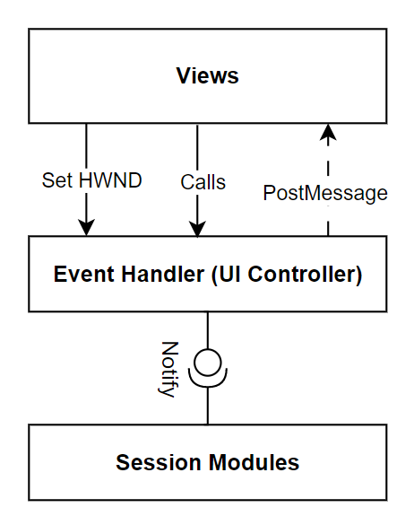
Lesson Learned : What worked well
Database & account management w/ JSON
UI Controller / media module w/ Observer pattern
JSON Database
UI Controller

Slide 21
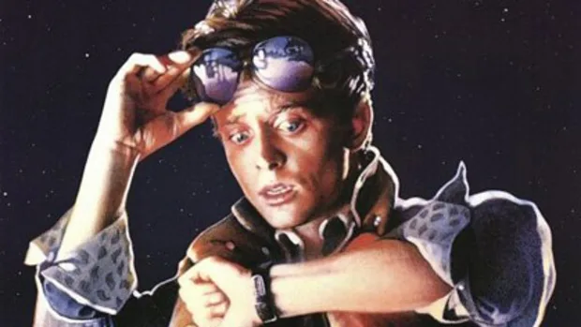
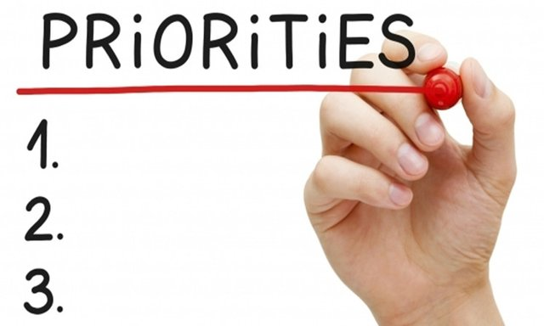
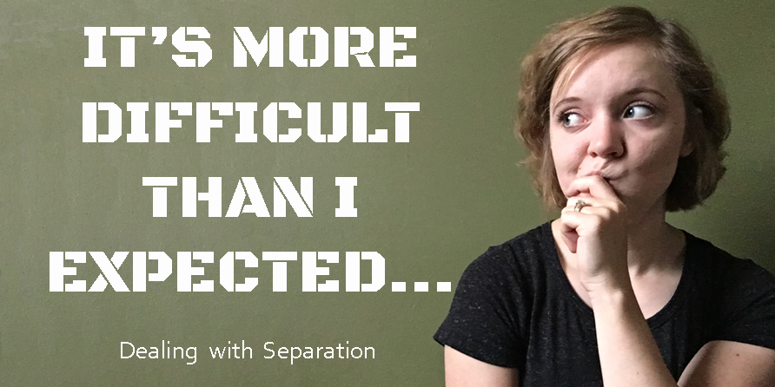
Lesson Learned …
Trade off of completeness and schedule
In order to implement everything, you may miss something important.
Things always turn out to be more difficult than expected.
Are we a software architect from now on ? Already !
Notes:
Trade off of completeness and schedule
In order to implement everything, you may miss something important.
Things always turn out to be more difficult than expected.
Software has no right answer, but it is an important tool for solving problems.

Slide 22
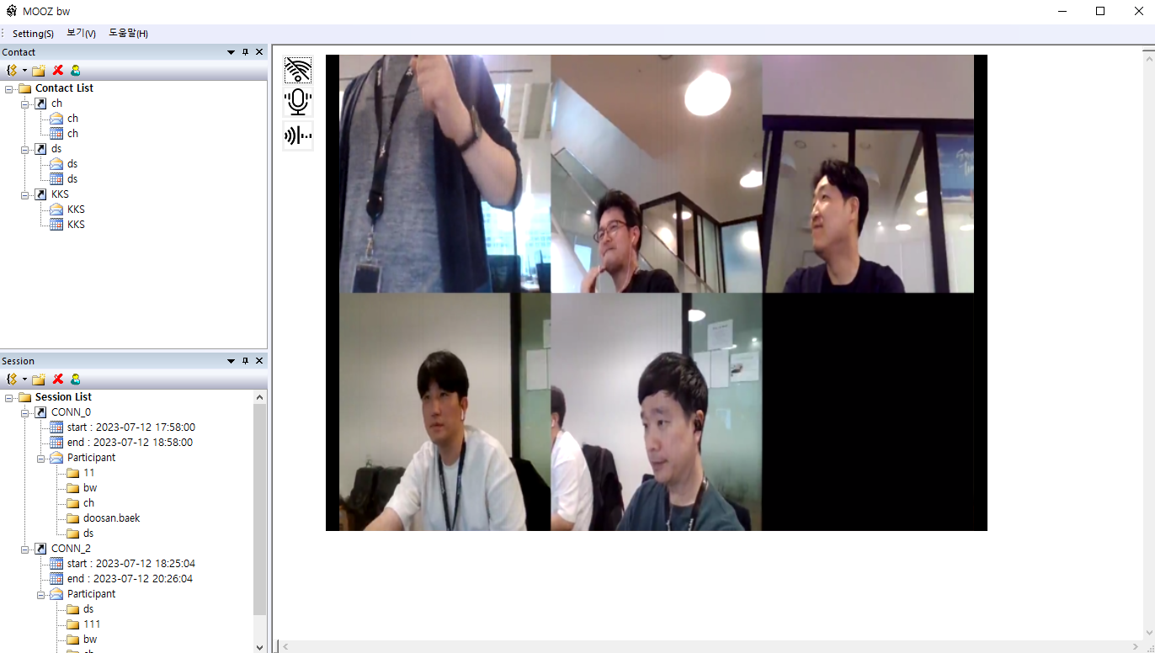
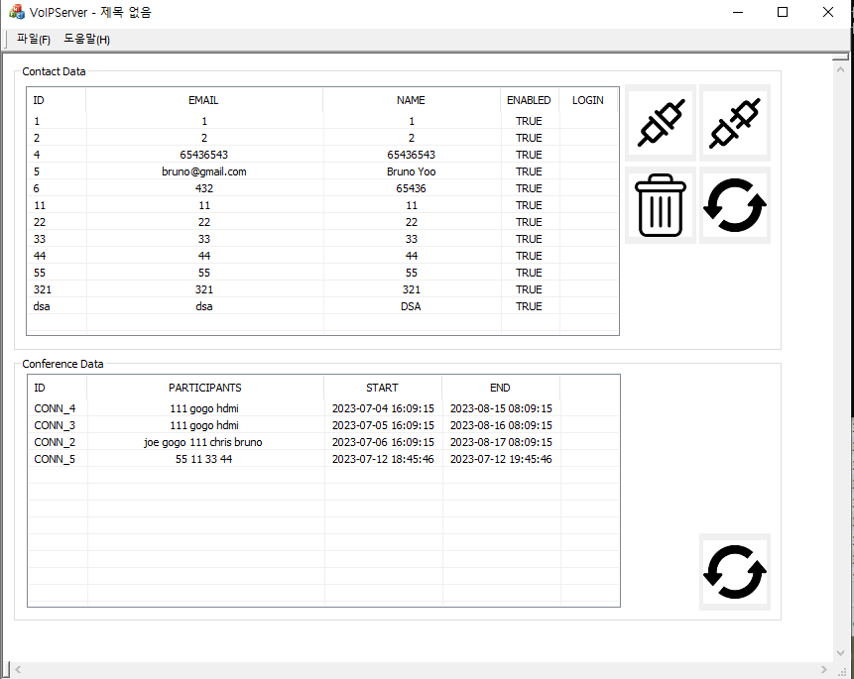
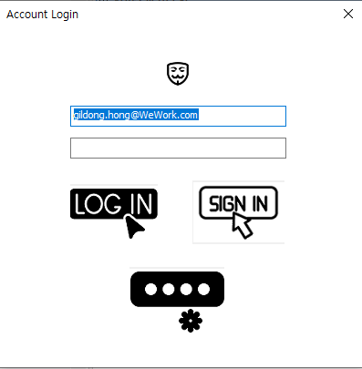
Final product

